Slide 1

Theoretical Fit
Mykola Chernyashevskyy

Slide 2
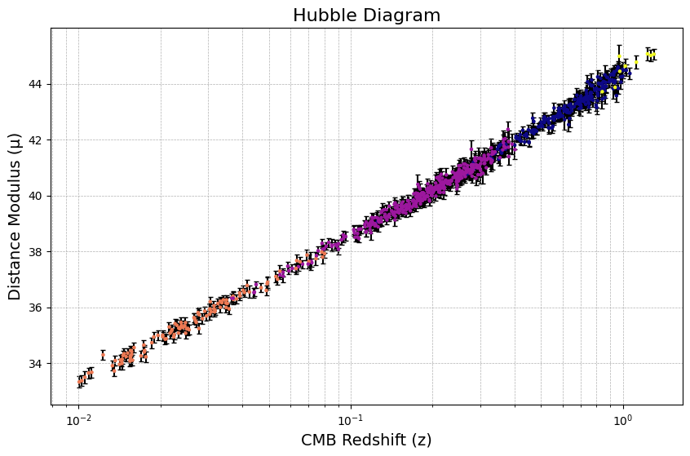
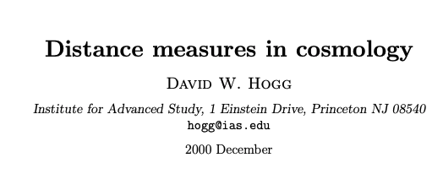
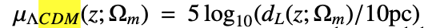
Last Meeting

Slide 3
Answering Question: Can I include Mb
When Lambda CMD is and why does it say Sigmak is ok.

Slide 4
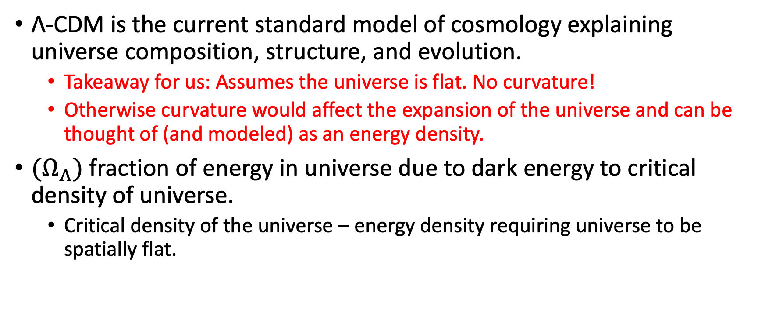
Λ-CDM Model (Lambda Cold Dark Matter Model)
Λ-CDM is the current standard model of cosmology explaining universe composition, structure, and evolution.
Takeaway for us: Assumes the universe is flat. No curvature!
Otherwise curvature would affect the expansion of the universe and can be thought of (and modeled) as an energy density.
${(Ω}_{Λ})$ fraction of energy in universe due to dark energy to critical density of universe.
Critical density of the universe – energy density requiring universe to be spatially flat.

Slide 5
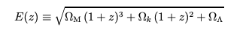
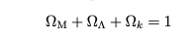
D. Hogg Paper Derivation of
From Λ-CDM:
Planck Satellite

Slide 6
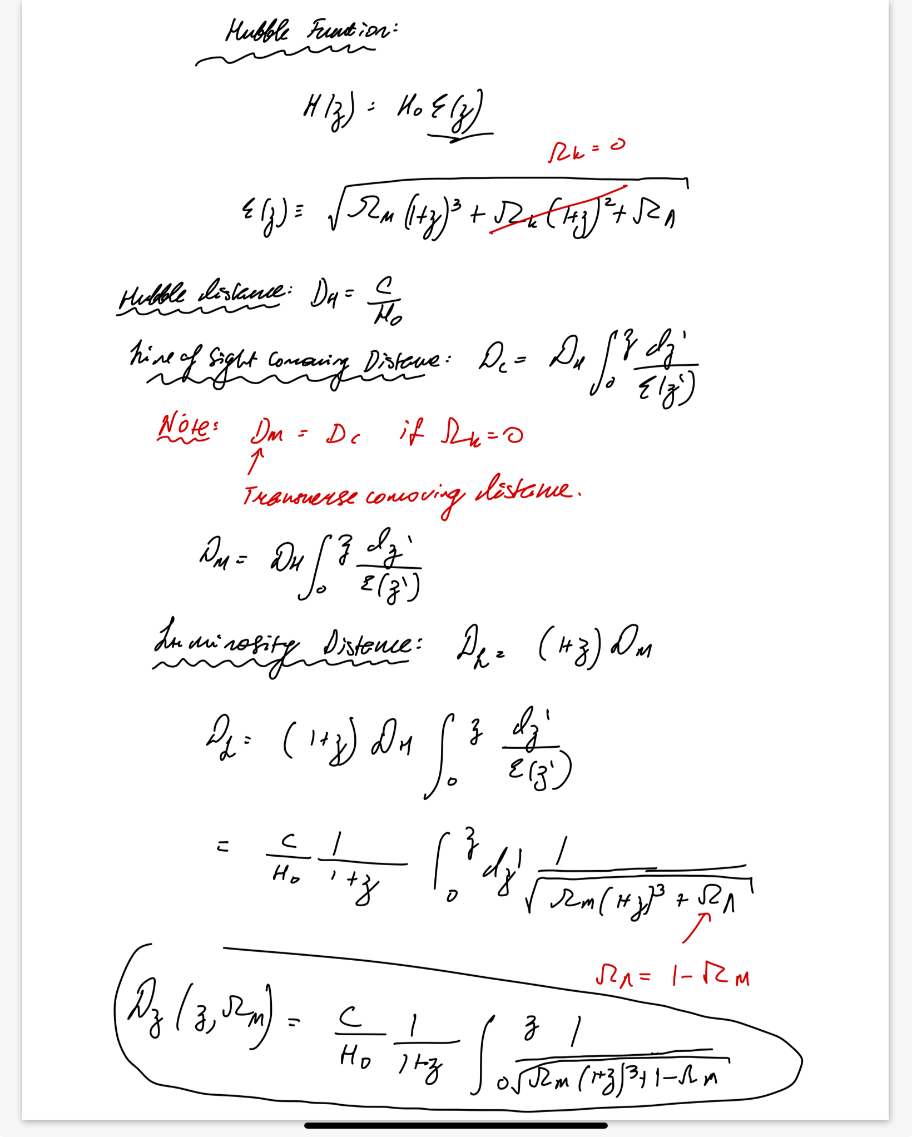
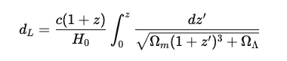
D. Hogg Paper Derivation Continued
1 – Omega_m
Plug this back into the following equation for each
galaxy:

